Slide 1

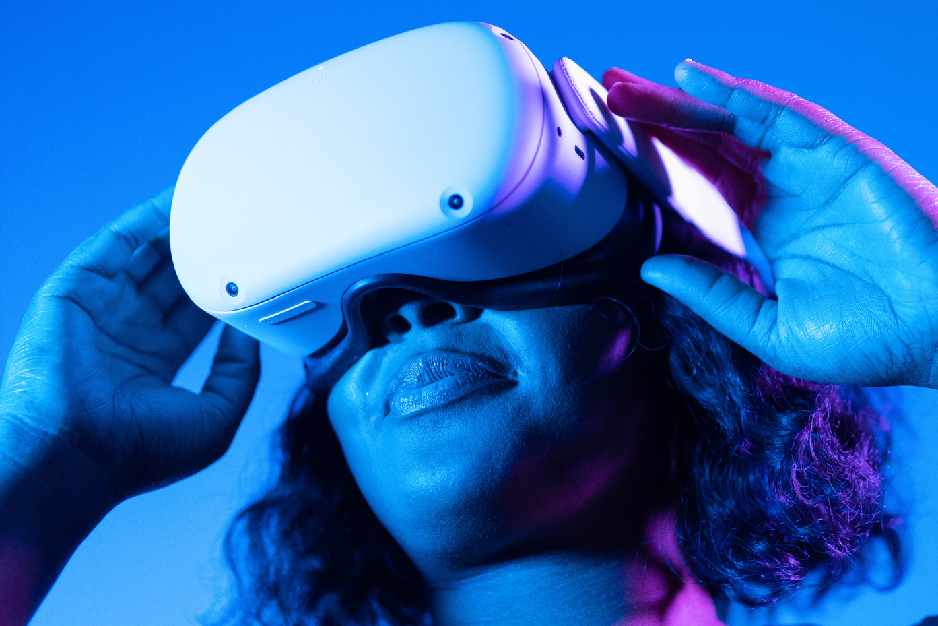
24-1-D-17
Preliminary diagnosis of Alzheimer's disease using Virtual Reality
Advisors: Dr. Anat dahan
Dr. Marcela Viviana Karpuj
By: Aviv Ben Ezra & Tali Azoulay
1

Slide 2

Alzheimer's Disease
Alzheimer's disease is a global challenge.
AD is a brain disorder characterized by changes in the brain that lead to the deposition of certain proteins.
Subtype of dementia.
Main symptoms: Memory Loss, Cognitive Decline, Behavioral Changes, Difficulty with Daily Tasks.
Impacts the entire family as the patient becomes unable to perform daily functions.
2
Notes:
affecting millions worldwide, with no current cure. But early diagnosis aids in slowing down the spread.
Alzheimer's disease (AD) is a neurological condition characterized by struggling to perform the daily routine. AD characterized by memory loss, cognitive decline, and even behavioral changes. It represents a significant global challenge, affecting millions of individuals and their families worldwide, with numbers expected to increase as populations age.

Slide 3



Early Diagnosis Is Crucial
Helps slow disease progression.
Improves quality of life for patients.
Facilitates appropriate treatment.
3

Slide 4
Current Preliminary Diagnosis
Current assessments include quizzes, memory tests, and motor skills evaluations.
Preliminary assessments for AD lack precision.
Additional evaluations often needed for accurate diagnosis.
Current assessments are limited by physical space and fail to accurately mimic daily life.
4
Notes:
today, the subject arrive to the clinic with A referral from his family doctor and perform a serie of assessments.
early diagnosis is crucial because it can help manage symptoms and slow the progression of cognitive decline.
Today, preliminary assessments for AD often lack precision, necessitating additional evaluations for accurate diagnosis. Current assessments confront limitations, including constraints in physical space and the struggle to examine daily functions like using the bus or shopping in the supermarket. Due to these challenges, there is a growing interest in developing alternative methods such as virtual reality (VR) tests. VR technology has progressed to a level where it can effectively simulate reality, offering realistic environments for cognitive assessments. VR assessments are considered to be successful in preliminary AD diagnosis.

Slide 5
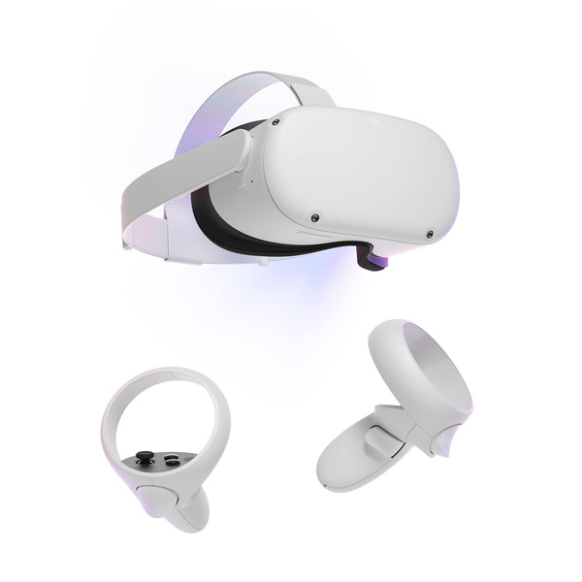
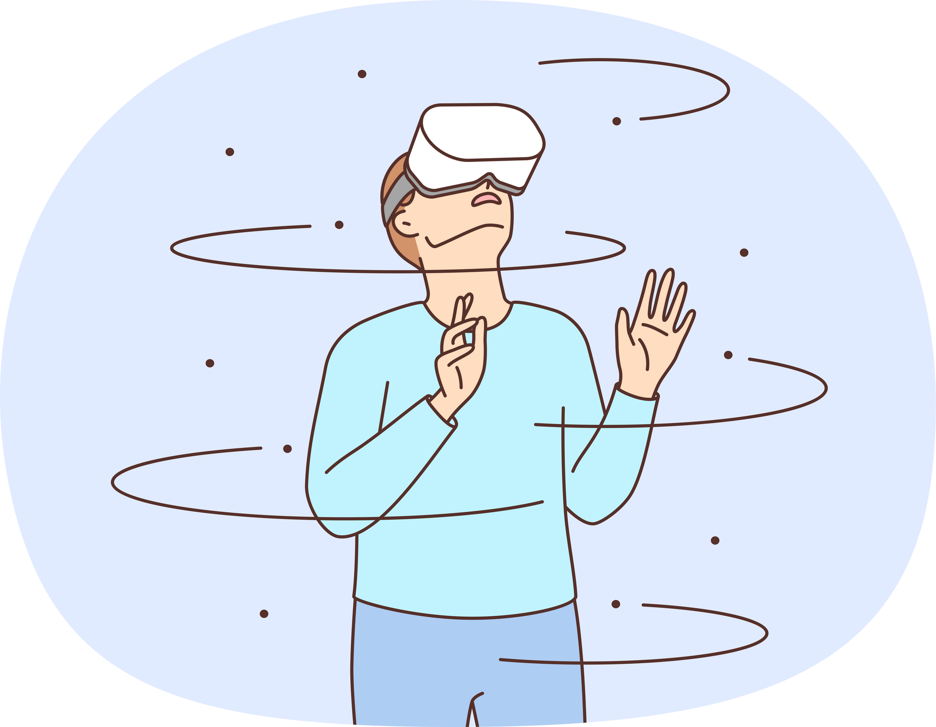
VR Test
VR technology can effectively simulate reality.
VR assessments are proven successful in preliminary AD diagnosis.
Additional assessment for diagnose.
Simulate the routine functionalities.
Aims to improve accuracy.
5
Notes:
Unique perspective: Complements traditional diagnostic methods
The aim of the project is to develop a test that will serve as an additional assessment tool for diagnosing doctors. This test will provide insights into the medical factors influencing the daily functionality of the subject, offering a rare perspective that complements traditional diagnostic methods. By integrating medical insights with observations of the subject's daily activities and functioning, the test aims to enhance the accuracy and comprehensiveness of the diagnostic process, ultimately leading to better patient care and management.

Slide 6

The Virtual Supermarket Test (VST)
Supermarket VR test aims to assess cognitive function in a realistic environment.
Participants navigate virtual supermarkets, completing tasks akin to real-life shopping.
Test evaluates spatial navigation that differ AD and other dementia diseases.
Got few versions. proven as a good AD diagnose.
The subject watches several short videos and is required to replicate the route.
Customized VST in aim to simulate better the israeli envirment.
6

Slide 7

Quick Summary
Important Preliminary
Hard to Diagnose
VR assessments
Carmel Hospital
Slowing propogation
AD or bad memory?
Simulate reality efficiency
Adapt existing VR assessment
7
Notes:
Current Challenges:
Traditional paper-and-pen tests can be exhausting for patients, leading to increased anxiety and less accurate results. These tests often fail to capture the complexities of daily life functioning and do not provide a realistic assessment of cognitive abilities in real-world scenarios

Slide 8
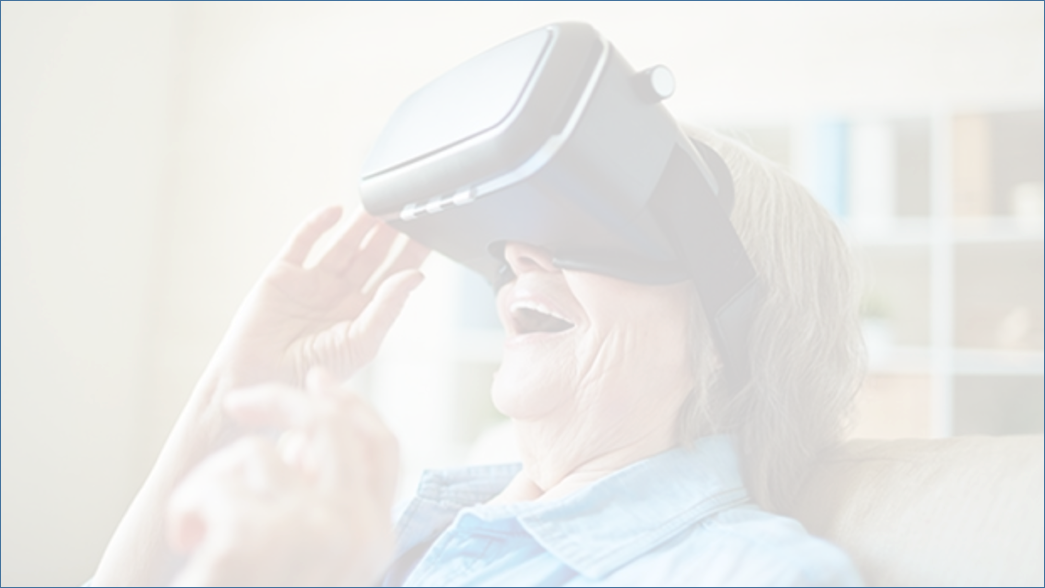


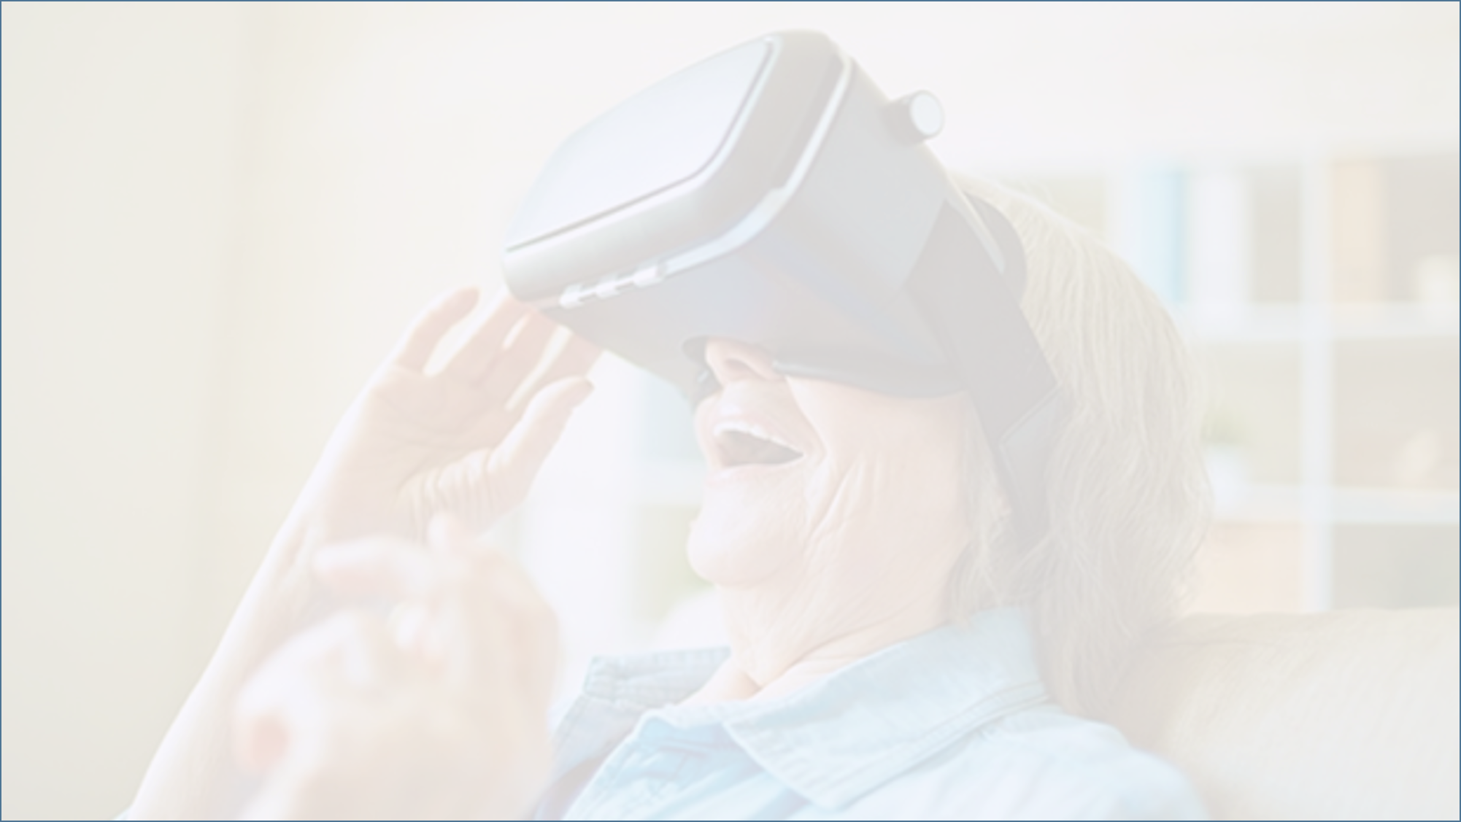
PRODUCT
8

Slide 9

Product Description
Navigation in a Supermarket Virtual Environment.
The subject watches a short video displaying a route and selects the correct product.
While navigating, the subject answers the phone when it rings.
9
Notes:
Our Goal:
To adapt and enhance an existing VR-based diagnostic system to meet specific needs identified in our recent interviews, including time limitations, personalization, and realistic environments.
The test will involve guiding the patient through a virtual supermarket, after which they will be asked to restoring the route. The test will be time-limited to ensure efficiency.

Slide 10
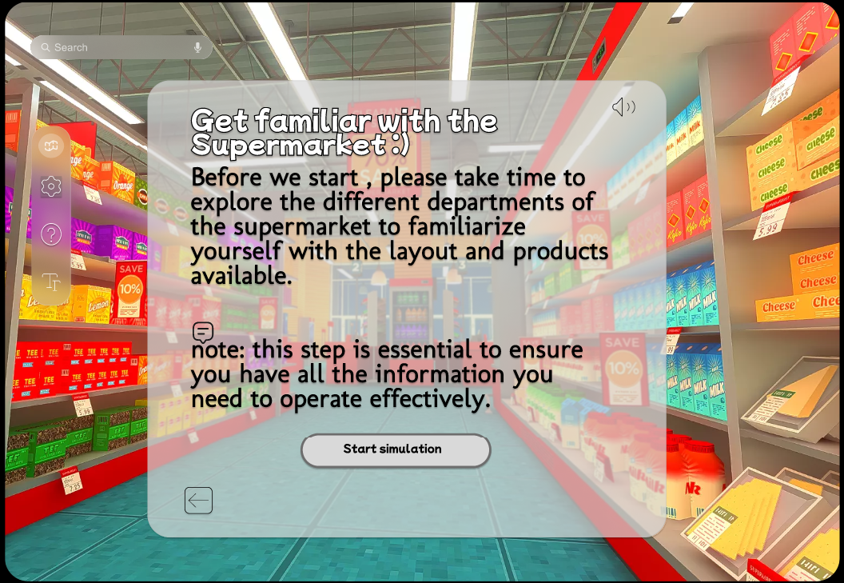

Product
Screen Flow
10
Notes:
At the beginning, the subject is prompted to engage in a simulation. This exercise aims to familiarize the subject with the system and acclimate to the Oculus.

Slide 11

Product
Screen Flow
11
Notes:
the subject views a brief video which display a route and a product picking. After that, the subject is tasked with restoring the route and selecting a product from the shelves.

Slide 12
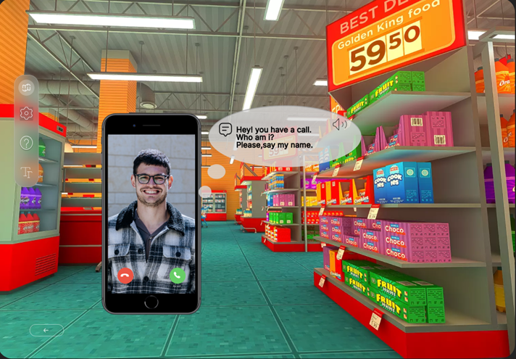
Phone Call Challenge
During the test, a smartphone displays photos, and the subject is tasked with identifying and naming the family member shown in the photo.
measuerd:
Correct or Incorrect identification.
The time it takes him to identify/continue.
emotional respond.
12
Notes:
The uniqeness lies in a ability to combine daily functions with regular interrupstions.
tests the subject's cognitive and multitasking abilities in a realistic scenario.
Evaluting the patiant ability to maintain focous on the navigation task after the cognotive interuption.
We plan to evaluate several crucial parameters that could help identify specific cognitive impairments.

Slide 13

Product- Measured Variables
Wrong turns.
Collisions with shelves or items.
Frequency of returning to the same point.
Monitor the frequency of errors made during tasks.
13
Notes:
In a VR diagnostic setting, the following measures can provide insights into the cognitive abilities and spatial navigation skills of patients suspected of having Alzheimer's disease.
measuring variables that could indicate cognitive impairment and assist in diagnosing Alzheimer's Disease (AD), we focus on metrics that highlight changes in cognitive functions typically affected by AD.

Slide 14


Unique Adaptations
Time limit: 5 minutes
Realistic environments with israeli products
Identification Challenge
14
Notes:
Meets Carmel Hospital's time limitations with a concise five-minute assessment segment.Unlike the VST, which consists of multiple short trials totaling several minutes (14 videos), our software aims to streamline the diagnostic process with fewer but more intensive tests, reducing overall testing time without compromising diagnostic accuracy.
Simulates the Israeli atmosphere, providing a familiar and realistic experience for users.
Using a familiar environment in cognitive tasks can indeed improve patient engagement particularly for individuals with cognitive impairments like Alzheimer's disease.(Increased Comfort and Reduced Anxiety)
By incorporating dynamic of real scenarios whos mimic real-world interactions
,VR assessments can reveal impairments in handling unexpected changes and emotional responses, which are often challenging for Alzheimer's patients.
At the same time tests multiple cognitive functions, including navigation, memory, and concentration, in a short period.

Slide 15
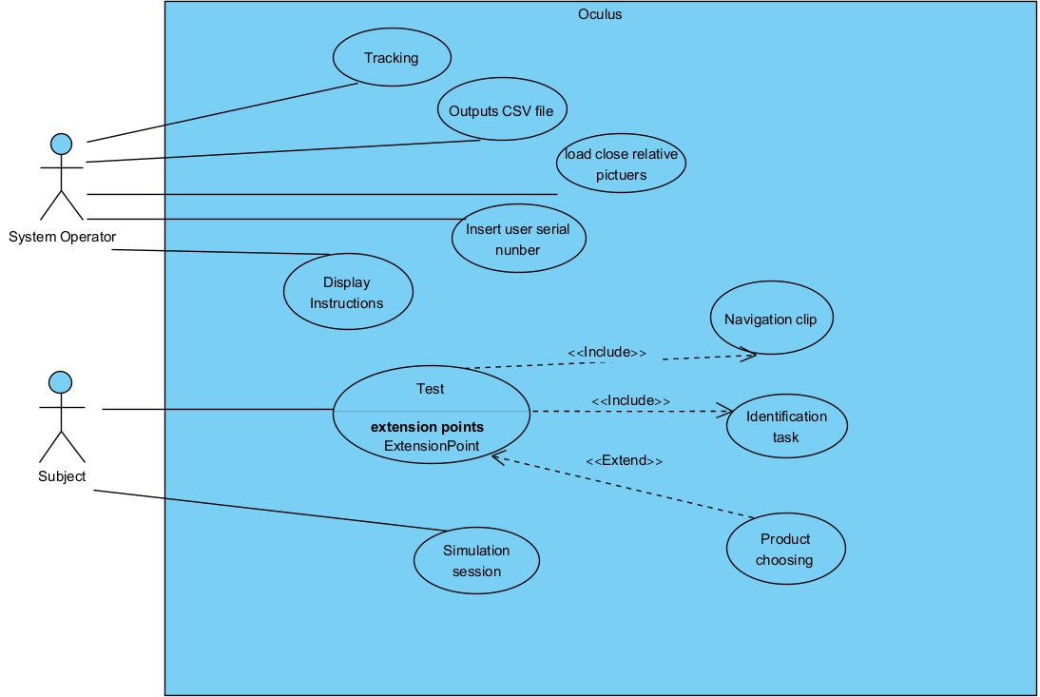
The Primary Functionalities
15
Notes:
The operator inputs the subject's test serial numbers.
The use case diagram illustrates the primary functionalities of the system, aligning with Dr. Spector's requirements. Two main users are identified: the system operator and the subject. Test execution stands out as the central function

Slide 16
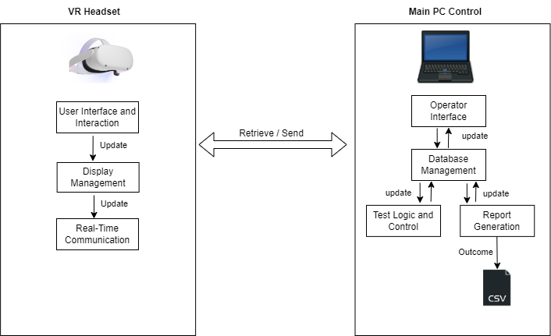
Product
Architecture
16
Notes:
Initialization: Before starting the test, the operator inputs the subject’s serial number into the Main PC Control and configures the initial test environment based on the planned setup to the VR headset.
During the Test: The VR headset sends real-time data about the user's movements and responses to the Main PC Control. The control unit processes this data, Additionally, it sends the user's interaction data to the operator interface, allowing the operator to track progress and take notes on the measured variables of the test.
Post-Test: The Main PC Control processes and compiles the test results into a CSV file, This file is then accessible via the operator interface for further review and analysis.

Slide 17
System Evaluation - Future
Ensures reliable assessments across different populations by including control groups.
Evaluate system's sensitivity and specificity in distinguishing individuals with AD from those without.
Present the system to Carmel Hospital.
17
Notes:
The system will first be tested by a team to calibrate it for healthy individuals, after this calibration, we will test the system on AD patients at various stages of the disease.
from other Nurodegenerative conditions.
To implement the VR diagnostic system on actual patients at Carmel Hospital, in timeframe of one semester probably not be enough suffice due to necessary ethical approvals and regulatory tests.

Slide 18


Challenges and Limitations
Hardware Requirements.
Comfort and Usability.
Motion Sickness.
Time limitation:
The time constraint specified by Dr. Spector
limited time frame of one semester allocated for system development.
Data Privacy and Security.
18
Notes:
Hardware Requirements:High-quality VR systems, like Oculus, require significant investment in hardware, which might be a problemathic for some healthcare facilities.
**Comfort and Usability:** Some patients, particularly the elderly or those unfamiliar with technology, may find VR systems uncomfortable or difficult to use.
What will make the experience comfortable
- **Motion Sickness:** VR environments can cause motion sickness or dizziness in some users, which could affect their performance and the accuracy of the diagnosis.
Time limitation -
Data Privacy and Security
To ensure data privacy, we only save the subject's serial number without using their medical information. The medical assessment will be conducted by an expert doctor based on the test results.

Slide 19

1
Improve AD diagnosis
2
Customized VST
Summary
3
Reliability and Differentiation
4
Innovative Clinical Utility
5
6
19
Notes:
Reliability and Accuracy:
Ensures reliable assessments across different populations by including control groups and calibrating the system with healthy individuals. This rigorous testing process guarantees the system's diagnostic precision and dependability.
Early Diagnosis and Differentiation:
Aids in the early and accurate diagnosis and differentiation of Alzheimer's disease from other neurodegenerative conditions. By detecting early signs such as spatial navigation impairments, the system allows for timely intervention and management, potentially slowing the progression of the disease.
Comprehensive Cognitive Evaluation:
Our system offers a thorough assessment of cognitive functions, combining personalized and realistic scenarios with unique identification tasks. This holistic approach provides valuable insights into the patient's cognitive health, beyond what traditional diagnostic methods can offer.
Enhanced Patient Care:
By reducing anxiety and providing a more engaging assessment environment, our VR diagnostic system improves the overall patient experience. This patient-centric approach not only enhances comfort but also ensures more accurate results by minimizing stress-related interference.
Clinical Utility:
Designed for ease of use, the system requires minimal training for healthcare professionals,
The system's continuous monitoring capabilities allow for ongoing evaluation and adjustment of treatment plans based on real-time data.

Slide 20

Thank you ! ☺
20

